Slide 1
AR/VR Companies

Slide 2
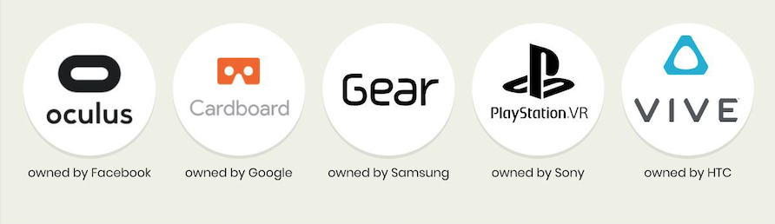
Some Popular VR Brands
source

Slide 3
Oculus by Facebook
Facebook has pumped billions into VR
$100 Million in Revenue
20% (contributed by users spending on content)

Slide 4
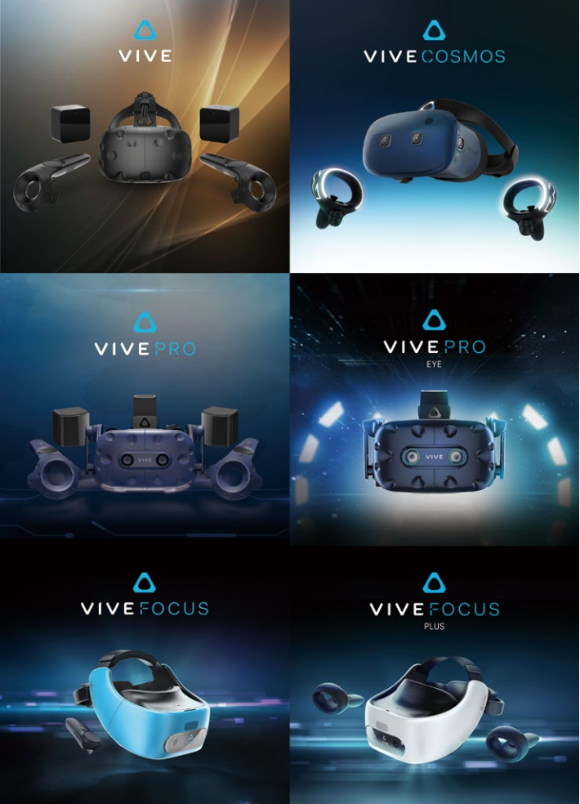
HTC
January 2018 business cooperation with Google Inc ($1Billion to HTC)
Contributed to net income NT$12.0 Billion, EPS NT$14,72

